Slide 1
Final Capstone Project Presentation

Slide 2
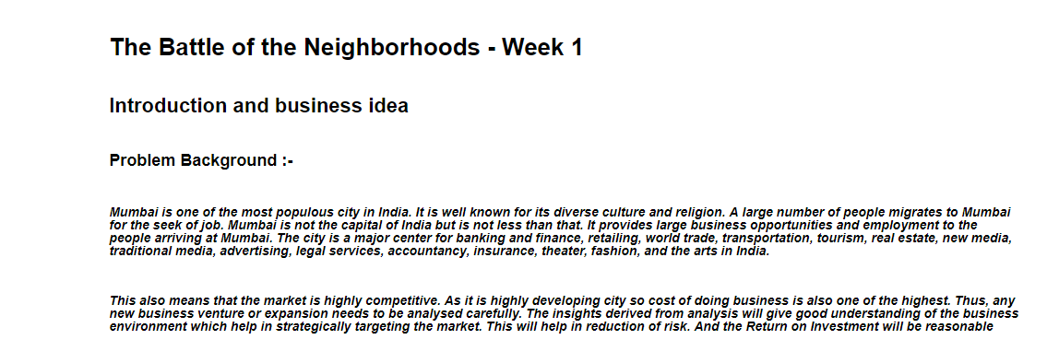
INTRODUCTION AND BUSINESS IDEA

Slide 3
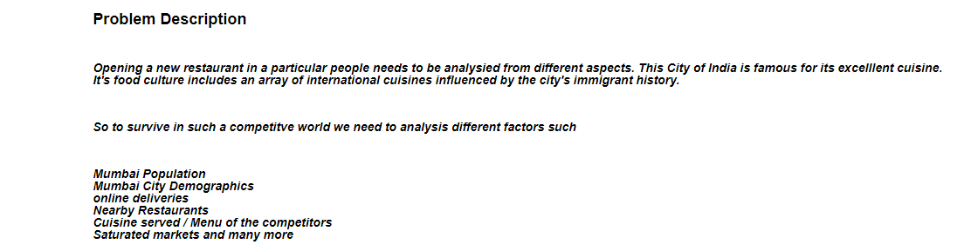
PROBLEM DETAILS

Slide 4
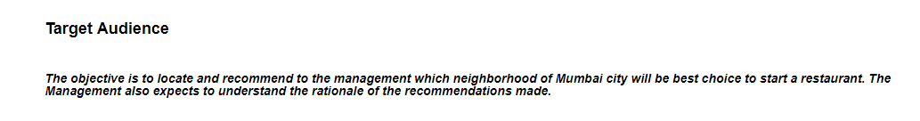
TARGET AUDIENCE

Slide 5
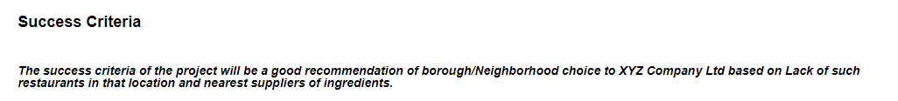
SUCCESS CRITERIA

Slide 6
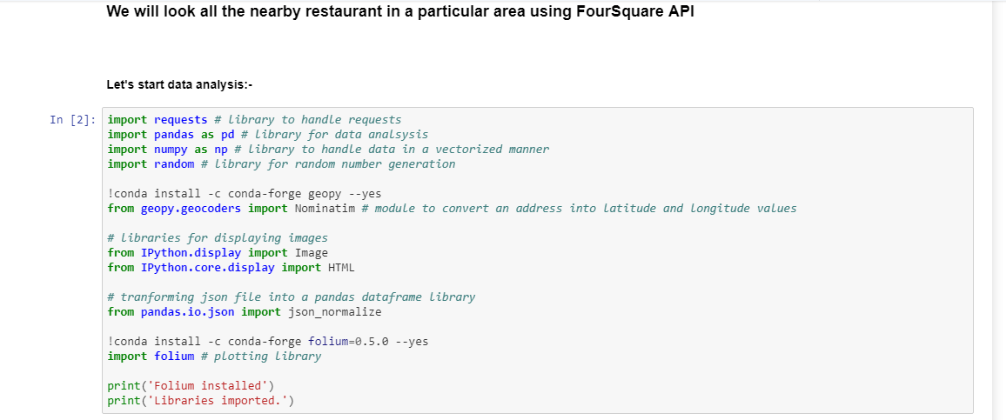
IMPORTING LIBRARY
I used Foursquare API for finding the location of different places.

Slide 7
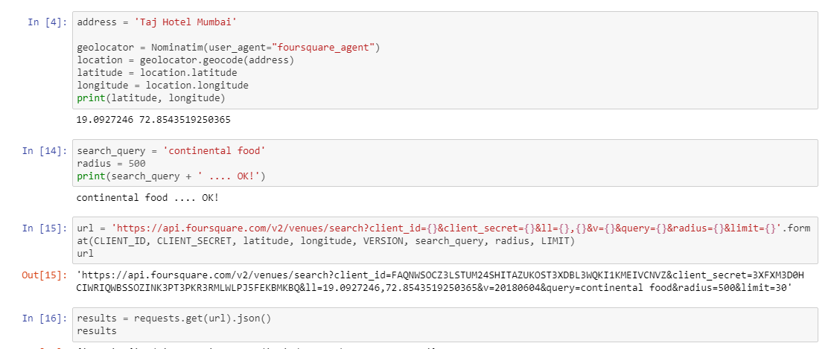
LOCATION AND SEARCH QUERY

Slide 8
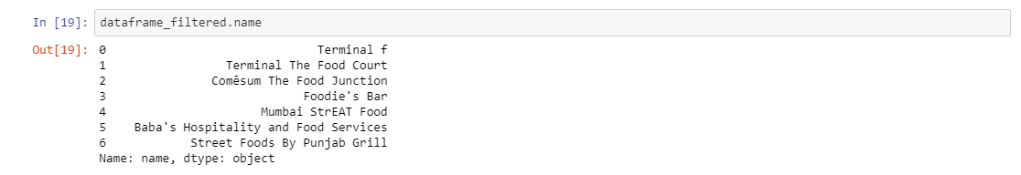
Neighbor Restaurant

Slide 9
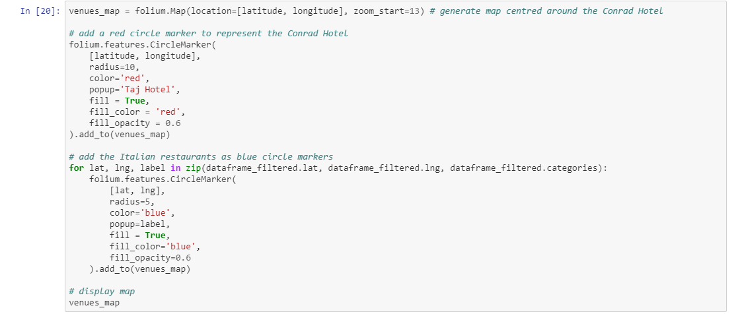
Using Folium Map for Location

Slide 10
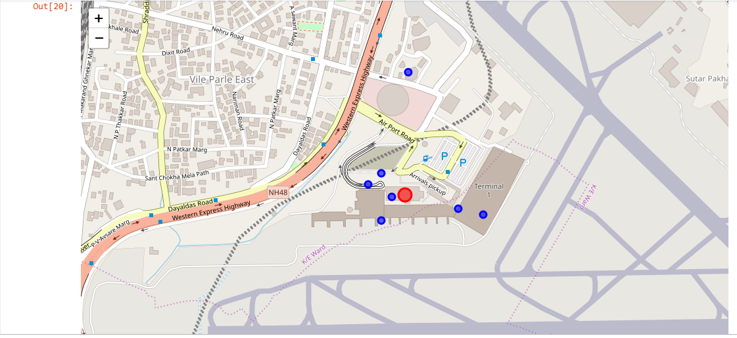
Map

Slide 11
Conclusion

